Slide 1
Detecting Pneumonia
D7047E
Group 8: Axel Alvarsson, Lisa Jonsson, Albin Thomsson
Notes:
Manus:
Hi all, we are group 8, Axel, Lisa and Albin :)
We chose to work on the pneumonia detection problem. The main goal of this project is to measure and compare two modern pretrained CNNs with the best possible performance.
I’m sure you’re all familiar with the problem description from all of the great explanations we’ve had previously today, so let’s jump into it!

Slide 2
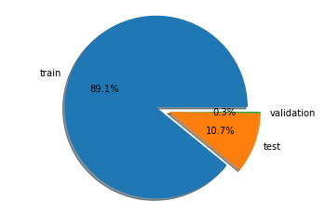
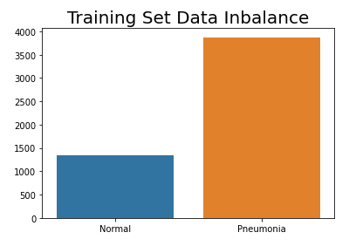
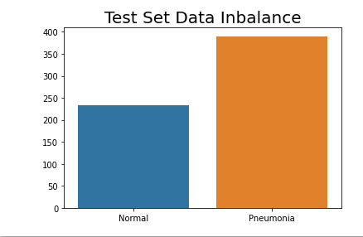
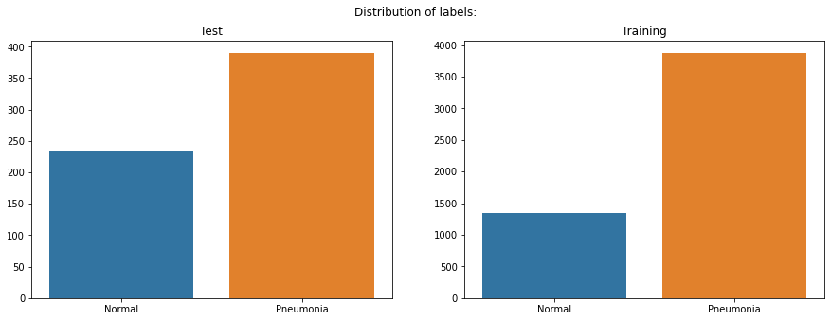
Data Analysis & Reasoning
Talk about:
Train, Test and validation split
Imbalanced
Dataset size
Feature Extraction vs Fine Tuning
Notes:
- Started by looking at dataset, large, small, classes, distribution, balance.
- Reasoning regarding data analysis. What were our aim at this stage? Potential problems?
- Validation set split
- Feature/fine tuning what will probably be best? Some form of a start hypothesis
Why tackle tis problem using transfer learning?
LISA::::----
We discussed the fact that the dataset is quite small so a model from scratch would be difficult, therefore we chose to do transfer learning.
We also figured that feature extraction probably would result in worse metrics than fine tuning as the networks are trained on data that is not very similar to the pneumonia dataset. (TESTADE VI FEATURE EXTRACTION?)
Dataset is unbalanced, thus it could create bias towards a class. In this case, there is significantly more data points that are positive for pneumonia than negative for pneumonia, and we’ll see how that affects our results later on.
Manus:
Cause of unbalanced data we chose to rely on the F1 score the most since this keeps imbalance in mind.
The first thing we did after we chose this subject was to do some basic data analysis. The first thing you notice without even downloading the data is that it comes pre-split, into three different subsets. The infamous train,test,validation split. After having a quick glance at the size of these you can see that the validation set, in its entirety, contains only 16 images, 0.3% of the entire dataset with a perfect balance of 8 images being labelled Pneumonia and 8 images being labelled Normal. This distribution is not representative of the dataset as a whole. The dataset is unbalanced, most images are labelled Pneumonia.
Another issue we encountered early on is the size of the dataset. We have in total about 5.5k images, so training a vanilla CNN without transfer learning never entered our minds as a good strategy. But it did spark a conversation as to which of the two approaches we have used in the course when it comes to transfer learning would yield the best results, hang tight, there will be more on this later.

Slide 3
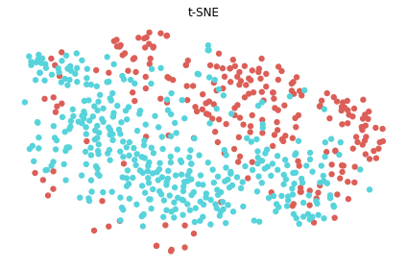

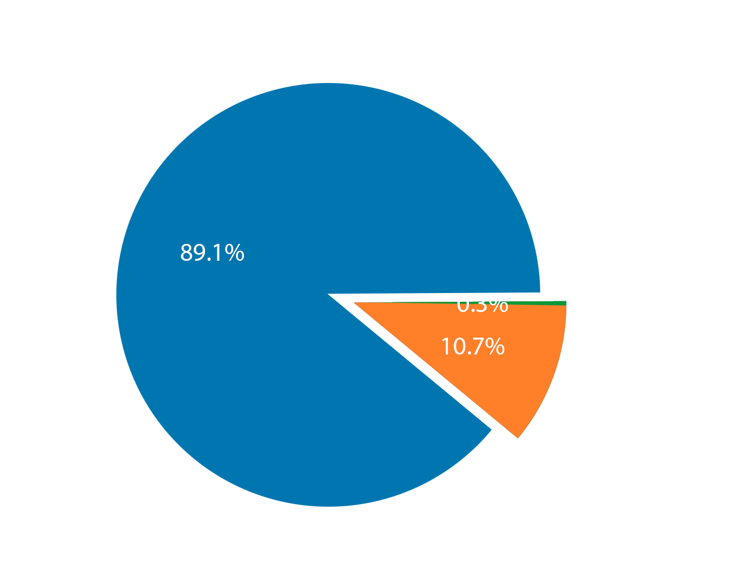
Data Analysis & Reasoning
Data set imbalance
Metric considerations, F1 score
Train, validation & test split
Dataset size
Notes:
NOTE: ska vi inte nämna vad vårt syfte är? Då det skiljer sig lite från andra kanske.
Manus:
The first thing we did after we chose this subject was to do some basic data analysis. Without even downloading the data you notice that it comes pre-split, into three different subsets. The infamous train,test,validation split. After having a quick glance at the size of these you can see that the validation set, in its entirety, contains only 16 images, which is 0.3% of the entire dataset with a perfect balance of 8 images being labelled Pneumonia and 8 images being labelled Normal. This distribution however is not representative of the dataset as a whole. The dataset is unbalanced, most images are labeled as Pneumonia, as you see in the histogram. This is important to note, because this means we need other metrics to look at instead of just accuracy to measure the performance of our binary classifiers. Another issue we encountered early on is the size of the dataset. We have in total about 5.5k images, so training a vanilla CNN without transfer learning never entered our minds as a good strategy. But it did spark a conversation as to which of the two approaches we have used in the course when it comes to transfer learning would yield the best results.
After this we also decided to create a t-SNE visualization of the dataset, in the image the blue dots are the pneumonia labels and the red ones are the normal ones. This picture was created from the training set, so it is about 600 individual images in total. As to what the t-SNE projection shows, we think its just how much they have in common and may lead to how difficult and tedious it is to classify an image or for a doctor to diagnose.
To combat the issue with a small dataset we wanted to focus on two things, use transfer learning to take advantage of pretrained CNNs with huge amounts of training and we wanted to do some data augmentation as a way to artificially increase the size of our dataset. We also wanted to work with some modern pretrained CNNs to try to get the best model we could. Up next is Axel

Slide 4
Method
Talk about:
Data augmentation methods and the dataset
Goal and planned methods to achieve said goal
Tools used and foreseen potential problems?
Notes:
- model selection
- data augmentation
-
Script:
To combat the issue with a small dataset we wanted to focus on two things, use transfer learning to take advantage of pretrained CNNs with huge amounts of training and we wanted to do some data augmentation as a way to artificially increase the size of our dataset. We also wanted to work with some modern pretrained CNNs to try to get the best model we could.
::::::::: AXEL :::::::::
NOTE:: Important to speak about our data augmentation in this case.
Since the dataset is very imbalanced, small, and lacks other information other than label, data augmentation and utilization of pre-trained models will be the saviour of this project.
So by data augmentation we can diversify the dataset without collecting more.
We obviously have a data class imbalance with more pneumonia classed images compare to “normal”. This is an issue as it becomes harder for the model to generalize well as the model might get overfitted to a dominant class during training and thus performs bad on new data. We believe this can be compensated for by weighting the loss of each class, i.e. the normal images will be given a higher weighting when evaluating the loss and vice versa for pneumonia classed images.
--- LISA ---
We discussed the fact that the dataset is quite small so a model from scratch would be difficult, therefore we chose to do transfer learning.
We also figured that feature extraction probably would result in worse metrics than fine tuning as the networks are trained on data that is not very similar to the pneumonia dataset. (TESTADE VI FEATURE EXTRACTION?)
Dataset is unbalanced, thus it could create bias towards a class. In this case, there is significantly more data points that are positive for pneumonia than negative for pneumonia, and we’ll see how that affects our results later on.

Slide 5
Method
Transfer learning
Data augmentation
ResNet and VGG19
Experiments to compare
Notes:
Script:
(Experiment different parameters and then compare them.)

Slide 6
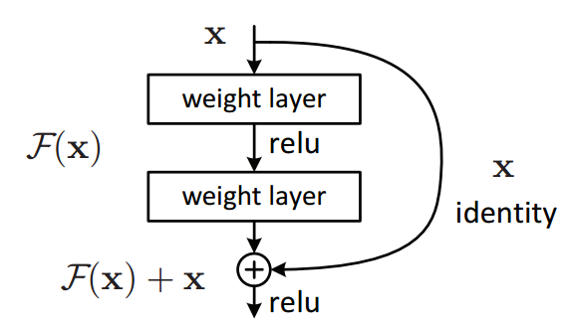
Implementation and Model Description
What makes the model architectures special?
ResNet
Residual Block
VGG
Kernel Size
Notes:
- Explain model architecture quickly
- Any unforeseen problems regarding model and data?
- Did we notice similarities or some differences?
Manus:
The time doesn’t really allow for a deeper look into any of our model architectures but we do at least want to cover what makes them “special”.
For ResNet, it is the residual block. ResNet is mostly like any other convolutional neural network other than the fact each layer feeds into the next layer and directly into the layers a couple of hops away. In a “vanilla CNN”, continuing to increase the number of layers and you will eventually encounter the degradation and vanishing gradient problem, and its inability to learn identity functions. This is what the residual connections or skip-connections helps remedy by allowing the network to skip some layers and at least match the accuracy of the shallow sub networks.
The thing that is most notable about VGG19 (and VGG in general) is that they use very small kernels in their convolution layers. For example we can use 3x3 kernels in 3 layers instead of one layer with a 7x7 kernel. The advantages of this is that it requires less parameters and it introduces more non-linearities (with more layers) while still maintaining the same effective receptive field as larger kernels.
VGG prevents overfitting by using dropout in some layers, to make it generalize better.
::::::::: AXEL :::::::::
ResNet implementation:
Just like any other CNN but with residual block. This adds the original input back to the output feature map obtained by passing the input through one or more convolutional layers. This seems like a small change but will drastically improve the layer depth this network can handle without encountering vanishing gradient. The residual blocks are better known as skip-connections, a method now widely used in other model architectures such as FCN and U-Net.
I used ResNet50 which has 48 convolution layers along with 1 MaxPool, 1 Average Pool layer. It also has an adaptive average pool layer which allows us to input images with different sizes.
---- LISA ----
VGG19:
Just in short, VGG19 is a CNN trained on ImageNet. 16 conv layers, 5 maxpooling layers with 3fully connected layers (NN) at the end. The only modifications we did to the architecture was to change the number of output classes to 2 instead of 1000. Input size 224x224x3 (RGB). They use 3x3 with 1 stride and a few 1x1 to increase non-linearity, maxpooling with a 2x2 window and stride 2. They use ReLU as their activation function. They use 3 3x3 convolutions instead of one 7x7 because it is 3 layers instead of one, meaning we get 3 non-linearities instead of one, this approach also requires less parameters. (27C^2 instead of 49C^2, where C is the number of channels). In training they used 0,5 dropout to decrease overfitting.
When implementing the fine tuning I ran into a problem where the loss would be NaN, this was fixed by decreasing the learning rate.
Another problem was that I ran out of RAM when I ran with too large batch sizes, I ended up with size 10.

Slide 7
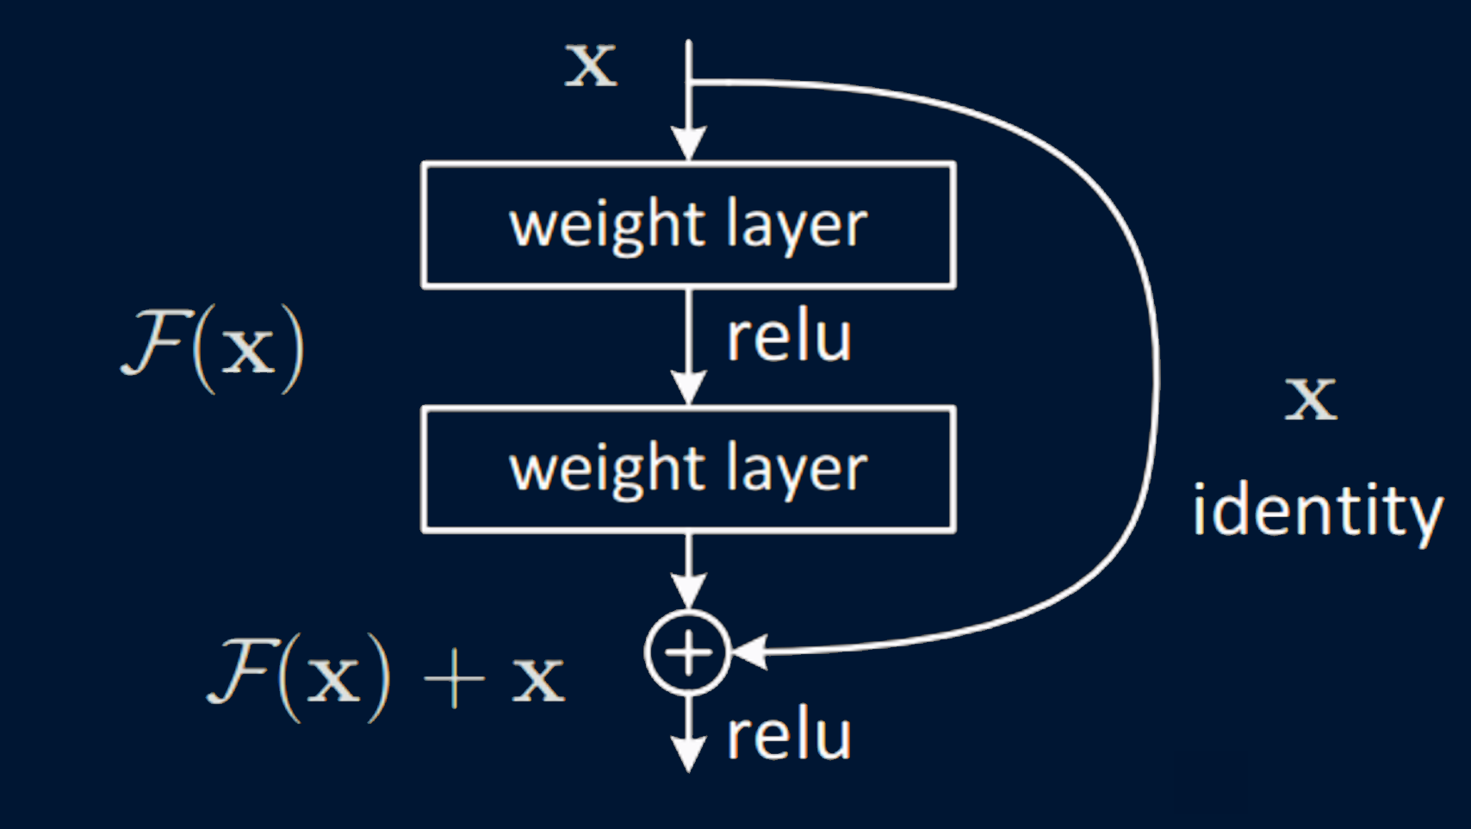
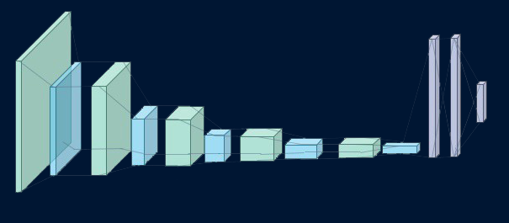
ResNet: Residual block
VGG19: Kernel size
Implementation and Model Description
What makes the models special?
Notes:
----------------AXEL-------------
Manus:
The time doesn’t really allow for a deeper look into any of our model architectures but we do at least want to cover what makes them “special”.
For ResNet, it is the residual block. ResNet is mostly like any other convolutional neural network other than the fact each layer feeds into the next layer and directly into the layers a couple of hops away. In a “vanilla CNN”, continue to increase the number of layers and you will eventually encounter the degradation and vanishing gradient problem and its inability to learn identity functions. This is what the residual connections or skip-connections helps remedy by allowing the network to skip some layers and at least match the accuracy of the shallow sub networks.
And now for a short introduction into what makes VGG tick.
------------LISA-------------------
The thing that is most notable about VGG19 (and VGG in general) is that they use very small kernels in their convolution layers. For example we can use 3x3 kernels in 3 layers instead of one layer with a 7x7 kernel. The advantages of this is that it requires less parameters and it introduces more non-linearities (with more layers) while still maintaining the same effective receptive field as networks that use larger kernels.
VGG prevents overfitting by using dropout in some layers, to make it generalize better.
::::::::: AXEL :::::::::
ResNet implementation:
Just like any other CNN but with residual block. This adds the original input back to the output feature map obtained by passing the input through one or more convolutional layers. This seems like a small change but will drastically improve the layer depth this network can handle without encountering vanishing gradient. The residual blocks are better known as skip-connections, a method now widely used in other model architectures such as FCN and U-Net.
I used ResNet50 which has 48 convolution layers along with 1 MaxPool, 1 Average Pool layer. It also has an adaptive average pool layer which allows us to input images with different sizes.
---- LISA ----
VGG19:
Just in short, VGG19 is a CNN trained on ImageNet. 16 conv layers, 5 maxpooling layers with 3fully connected layers (NN) at the end. The only modifications we did to the architecture was to change the number of output classes to 2 instead of 1000. Input size 224x224x3 (RGB). They use 3x3 with 1 stride and a few 1x1 to increase non-linearity, maxpooling with a 2x2 window and stride 2. They use ReLU as their activation function. They use 3 3x3 convolutions instead of one 7x7 because it is 3 layers instead of one, meaning we get 3 non-linearities instead of one, this approach also requires less parameters. (27C^2 instead of 49C^2, where C is the number of channels). In training they used 0,5 dropout to decrease overfitting.
When implementing the fine tuning I ran into a problem where the loss would be NaN, this was fixed by decreasing the learning rate.
Another problem was that I ran out of RAM when I ran with too large batch sizes, I ended up with size 10.

Slide 8
Results
Talk about:
Base line result vs best/most optimized end model.
Evaluation metrics, why use them and not just accuracy
Notes:
- Tested parameters for best possible model
- Evaluation metrics, why are some bad and some better.
- How did base line pre-trained result compare to best model
- Encounter over/under-fitting?
MANUS:
Ok, so before showing you the final results, let’s talk a bit about the process of getting there. With the model based on ResNet we experimented with learning rate, both manually and with a learning rate scheduler. We also tested out weight decay in the optimizer as well as gradient clipping. The only thing that seemed to make a big difference was the learning rate, the others did not affect results much.
With the VGG19 based model we tried different learning rates and momentum of the optimizer.
In both cases we tried different batch sizes, mostly because we discovered that the RAM would be flooded if we had too large batch sizes.
In the end these are the parameters we made our final models with. [SIDE BY SIDE COMPARISON ON SLIDE]
::::::::: AXEL :::::::::
ResNet: What parameters i tested with.
Learning rate, learning rate scheduler, seeded data augmentation previously mentioned, optimizer weight decay, gradient clipping. Although, scheduler, weight decay and gradient clipping seemed to have bad to no impact.
A question we have to ask is, what metrics of evaluation is actually meaningful? Accuracy is not a good evaluation metric when we have a big data class imbalance. It is much better to look at model recall and precision, and then their F1 score as well. For ResNet, the weightings could perhaps be tuned to improve the precision, but since recall and precision both are balance related, one has to be sacrificed.
Concerning overfitting, with this dataset it is likely to encounter overfitting. In ResNet we tried to counter this by selecting model weights that achieve “best” validation loss. However sometimes the best validation is achieved in the early epochs and it performs bad on the test set, most likely due to the imbalance probability of a batch. Thus we saved the best validation loss after certain epochs but if this is correct we do not know.
---- LISA ----
I've run the baseline quite a few times, results ranging from 43% to 64%. I'd say it on average is a 50/50, looks like guessing.
As with ResNet, we did some different experiments, these are the parameters we ran the end model with:
Learning rate: 10^-3, 0.001
Batch size: 10
Optimizer: SGD with momentum 0,9
This took 70 minutes to train on 5 epochs.
TRAIN data performance:
train Loss: 0.0061 Acc: 0.9983
accuracy: 0.9982745398773006
VAL data performance: (weird cuz only 16 data points)
val Loss: 0.0027 Acc: 1.0000
accuracy: 1.0
TEST data performance:
Acc: 0.9134615384615384
precision: 0.8853211009174312 recall: 0.9897435897435898 f1: 0.9346246973365618
Show conf matrix on test data. As we can see we have much more false positives than false negatives cuz of data set bias. This is however good in our case, cause in this application we would rather have false positives than false negatives.

Slide 9
Train parameters
ResNet
VGG19
Epochs: 20
Batch size: 64
Learning rate: 10⁻⁴
Gradient clip: None
Weight decay: 10⁻⁴
Optimizer: Adam
Weight compensation
Epochs: 5
Batch size: 10
Learning rate: 10⁻³
Gradient clip: None
Weight decay: None
Optimizer: SGD
Momentum: 0.9
Notes:
MANUS:
Before we started training we ran the test data through both models as they are to get some kind of a baseline understanding of how they performed.
For ResNet we got around 69% accuracy and for VGG19 we got results in the ranges 43 to 64%, averaging out to a 50/50, like guessing.
Ok, so before showing you the final results, let’s talk a bit about the process of getting there. With the model based on ResNet we experimented with learning rate, both manually and with a learning rate scheduler. We also tested out weight decay in the optimizer as well as gradient clipping. The only thing that seemed to make a big difference was the learning rate, the others did not improve results much. Some of them even made it a lot worse.
With the VGG19 based model we tried different learning rates and momentum of the optimizer.
In both cases we tried different batch sizes, mostly because we discovered that the RAM would be flooded if we had too large batch sizes.
In the end these are the parameters we made our final models with. [SIDE BY SIDE COMPARISON ON SLIDE]
(Point out differences)
Weight compensation counteracts the dataset imbalance.
--- SPLIT SLIDES----
::::::::: AXEL :::::::::
ResNet: What parameters i tested with.
Learning rate, learning rate scheduler, seeded data augmentation previously mentioned, optimizer weight decay, gradient clipping. Although, scheduler, weight decay and gradient clipping seemed to have bad to no impact.
A question we have to ask is, what metrics of evaluation is actually meaningful? Accuracy is not a good evaluation metric when we have a big data class imbalance. It is much better to look at model recall and precision, and then their F1 score as well. For ResNet, the weightings could perhaps be tuned to improve the precision, but since recall and precision both are balance related, one has to be sacrificed.
Concerning overfitting, with this dataset it is likely to encounter overfitting. In ResNet we tried to counter this by selecting model weights that achieve “best” validation loss. However sometimes the best validation is achieved in the early epochs and it performs bad on the test set, most likely due to the imbalance probability of a batch. Thus we saved the best validation loss after certain epochs but if this is correct we do not know.
---- LISA ----
I've run the baseline quite a few times, results ranging from 43% to 64%. I'd say it on average is a 50/50, looks like guessing.
As with ResNet, we did some different experiments, these are the parameters we ran the end model with:
Learning rate: 10^-3, 0.001
Batch size: 10
Optimizer: SGD with momentum 0,9
This took 70 minutes to train on 5 epochs.
TRAIN data performance:
train Loss: 0.0061 Acc: 0.9983
accuracy: 0.9982745398773006
VAL data performance: (weird cuz only 16 data points)
val Loss: 0.0027 Acc: 1.0000
accuracy: 1.0
TEST data performance:
Acc: 0.9134615384615384
precision: 0.8853211009174312 recall: 0.9897435897435898 f1: 0.9346246973365618
Show conf matrix on test data. As we can see we have much more false positives than false negatives cuz of data set bias. This is however good in our case, cause in this application we would rather have false positives than false negatives.

Slide 10

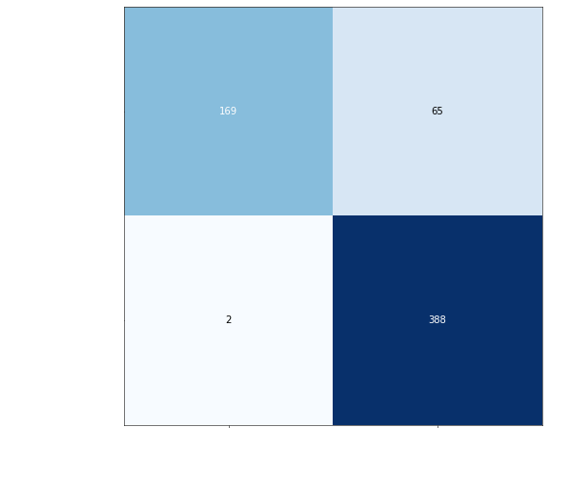
Performance metrics
ResNet
VGG19
Accuracy: 0.89
Recall: 0.99
Precision: 0.86
F1 Score: 0.92
Training time: 48 minutes
Accuracy: 0.91
Recall: 0.99
Precision: 0.86
F1 Score: 0.93
Training time: 71 minutes
Notes:
MANUS:
These are the final results [SIDE BY SIDE ON SLIDE].
Nice numbers, right? Some of these are better to look at than others though. Like Albin mentioned earlier, an important metric to look at is the F1 score because it gives a better view of the results because of the imbalanced data.
The two models performance are very similar, the two differences are that the VGG19 based model does slightly better in accuracy and F1 score.
Given these results, we can conclude that VGG performs slightly better when looking at the F1 score. However it takes close to double time to train.
[INSERT CONF MATRIX HERE].
If we take a quick look at the confusion matrices for the models we can see that there are a lot more false positives than there are false negatives. Why? Well because of the imbalance in the data set, since there are a lot more pneumonia labeled data points the models will be trained to have some kind of bias towards this label.
In our case this is not necessarily a bad thing. If we think about the use case of these models, wouldn’t we prefer that the models flag one person too much than miss a person with pneumonia?
I’ll let Axel elaborate more about our thoughts now…

Slide 11
Learning Outcome & Future improvement
Talk about:
Dat good stuf we lernid, hav reciv lot of informatjon
Do we maybe want to note what we would have done given more time?
Notes:
Manus:
So what did we as a group get from this project. Well obviously our understanding of ResNet and VGG have improved a lot and we feel comfortable with their structure and areas in which they excel. We learned that data analysis and the choices one makes based on the available data is crucial. For example, in this medical context one often encounter the DCIM format which contains much more data than just the image itself and not realizing or utilizing it could yield much worse results.
There are also some future improvements which we would have liked to implement if given the time. Given that our project aimed at an advanced comparison between pre-trained network models, the way we handled the data could have been better. This is not to say that the models results are invalid in any way but better communication is never bad. Both of the models performed well but for the sake of comparison, knowing that the only difference is the model architecture itself would have been nice.
We also read about some interesting performance enhancement methods, one of which is called channel-wise data normalization. Not to go into any detail at this point but this would help prevent any color of an image from having a wider influence on the weights during training simply because the color has a wider range in the given data. Implementing this and other possible improvements must unfortunately wait until this course runs its course…huehuehue
That’s it for us folks, thank you for the time and are there any questions?
::::::::: AXEL :::::::::
NOTE: Something that we should have tried given more time is channel wise data normalization on the images. This means that for each color channel we subtract the mean and divide by the standard deviation of each channel of the entire dataset, from each pixel. Generally this serves to prevent any color from having a wider influence on the weights during training as one of the colors can have a wider range in the given data.
---- LISA ----
Learned that the batch size is important for RAM usage as well as the training progress.
Learned more in depth of the VGG and ResNet architectures.
BOTH::::
We worked in parallel when developing VGG and ResNet models respectively. We ended up doing a few things different, such as preprocessing and data splitting (validation data). These differences makes any comparisons we make a little harder to interpret since we do not know 100% what the differences depend on. If we would do it again we would try to make the model comparisons more fair.

Slide 12
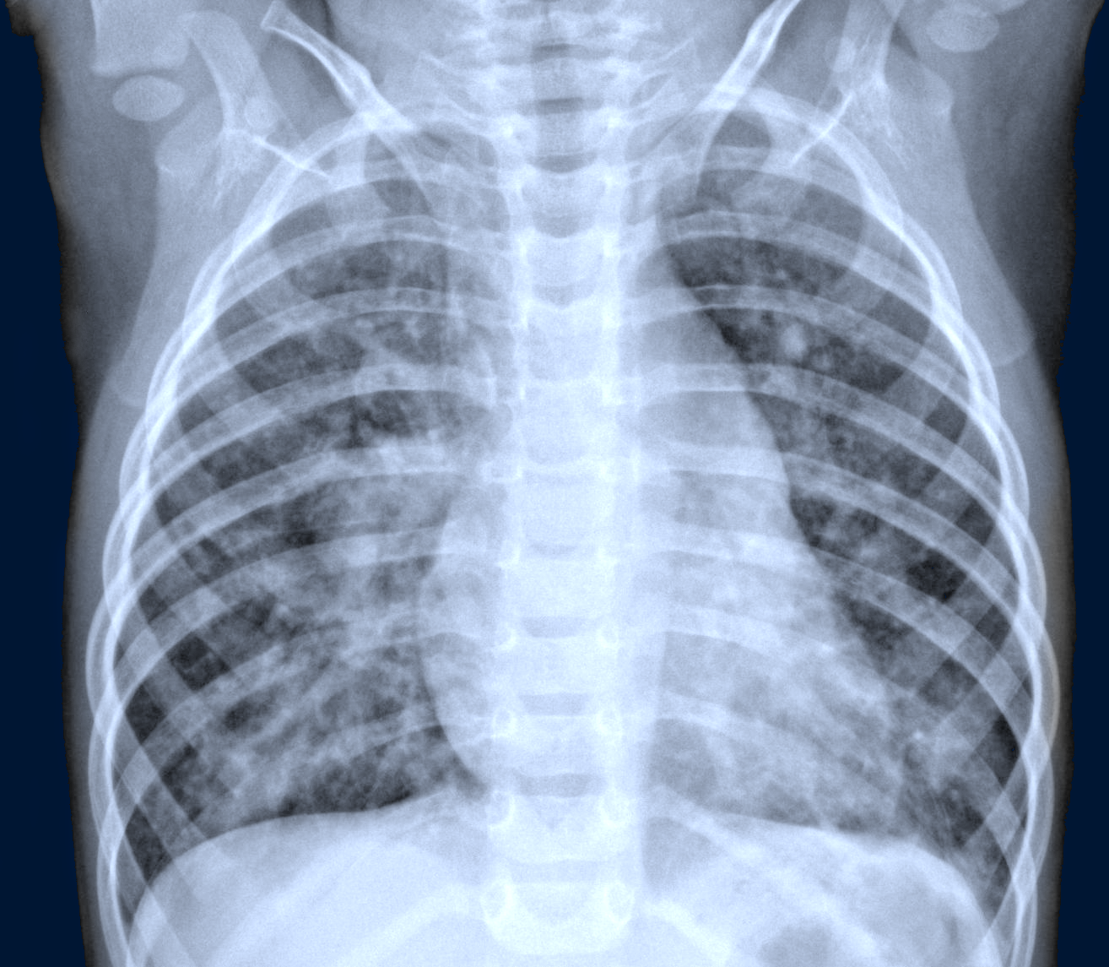
Learning Outcome & Future improvement
VGG & ResNet
Data analysis
Model comparison considerations
Channel-wise data normalization
Notes:
----------------AXEL-------------
Manus:
So what did we as a group get from this project. Well obviously our understanding of ResNet and VGG have improved a lot and we feel comfortable with their structure and areas in which they excel. We learned that data analysis and the choices one makes based on the available data is always crucial. For example, in this medical context one often encounter the DCIM format which contains much more data than just the image itself and not realizing or utilizing it could yield much worse results.
There are also some future improvements which we would have liked to implement if given the time. Given that our project aimed at an advanced comparison between pre-trained network models, the way we handled the data could have been better. This is not to say that the models results are invalid in any way but better communication is never bad. Both of the models performed well but for the sake of comparison, knowing that the only difference is the model architecture itself would have been nice. In the end of the project a lot of focus was on performance measurement and analysis, one thing we wished to try but did not find the time for was ROC curves, we could have used it for a better result comparison.
We also read about some interesting performance enhancement methods, one of which is called channel-wise data normalization. Not to go into any detail at this point but this would help prevent any color of an image from having a wider influence on the weights during training simply because the color has a wider range in the given data. Implementing this and other possible improvements must unfortunately wait until this course runs its course…
On a final note, the dataset contains only chest X-rays of children in the ages 1 to 5. So we are wondering as an open question to the audience, how would our models, or models such as ours, perform on X-rays of adults, would it matter? Would it be worse? What do you guys think?
That’s it for us folks, thank you for the time and are there any questions?

Slide 13
Questions?
https://github.com/Alvarsson/D7047E-Advanced-Deep-Learning/tree/main/project

